Slide 1
Bug detection and bug fixing

Slide 2
Introduction
Title: Why Bug Detection
MattersPoints:Bugs can lead to crashes, data loss, and security issuesEarly detection reduces cost and effortAutomation helps scale code qualityImage: Graph showing cost of fixing bugs over development stages

Slide 3
Types of Bugs
Common Bug TypesPoints:
Syntax Errors
Logical Errors
Runtime Errors
Semantic BugsImage: Table or icons for each bug type with example code snippets

Slide 4
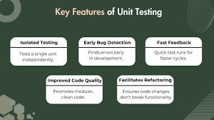
Traditional Detection Methods
Manual and Static TechniquesPoints:
Code ReviewsStatic Analysis Tools (e.g., pylint, SonarQube)

Slide 5
AI-Powered Bug Detection
ML and LLMs in Bug DetectionPoints:
Learn patterns from past bugsUse Transformers (e.g., CodeBERT, GPT)Predict buggy lines and suggest fixes

Slide 6
Our ApproachTitle
Our Bug Detection & Fixing PipelinePoints:
Data Collection (buggy & fixed code)Model Training (e.g., transformer)Prediction and Fix Generation

Slide 7


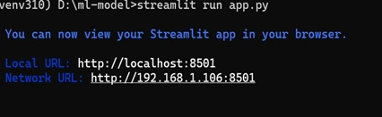
OUTPUT

Slide 8
THANK YOU

